Slide 1
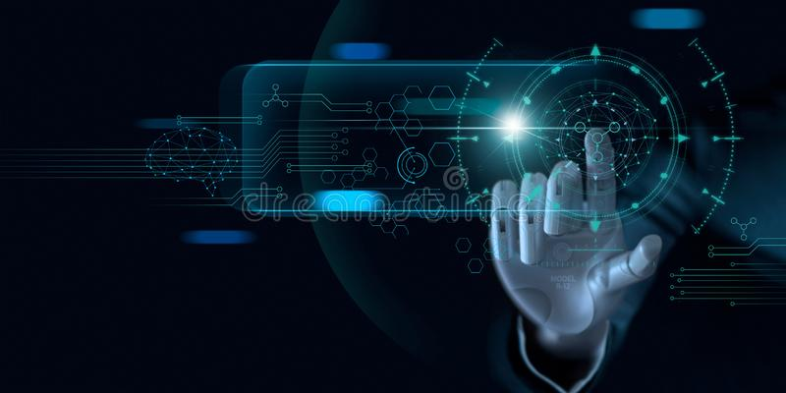
MACHINE LEARNING

Slide 2
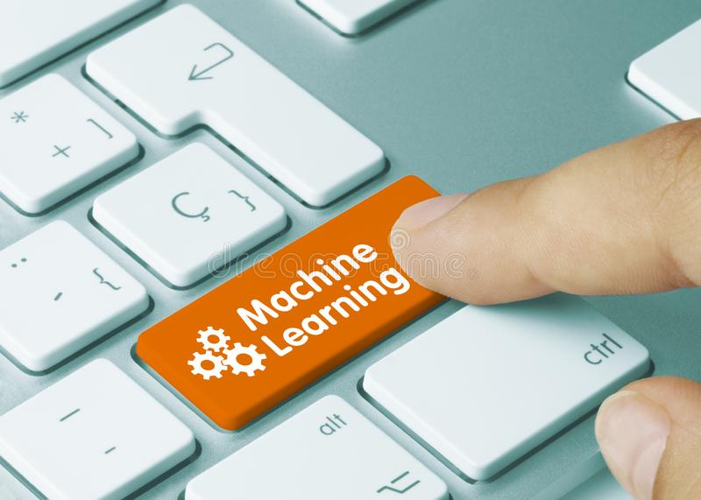
INTRODUCTION :
Machine learning refers to a system capable of the autonomous acquisition and integration of knowledge.

Slide 3
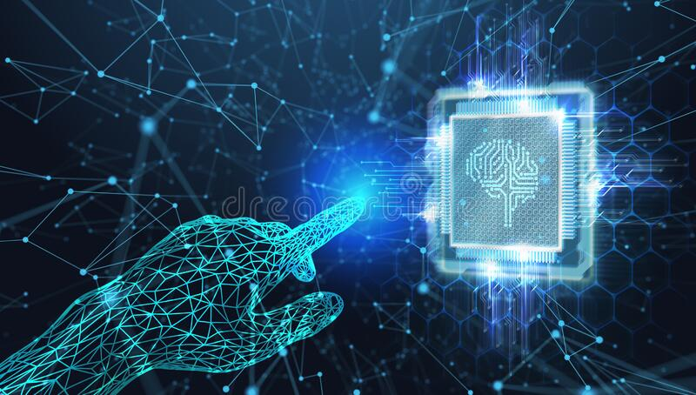
HISTORY :
Machine learning was invented by ARTHUR SAMUEL, first came up with phrase in 1952.
In 1957 FRANK ROSEN BLATT – at the cornel aeronautical laboratory – combined DONALD HEBBS model of brain cell intraction with arthur samuel’s machine learning efforts.
It creates the perceptron.

Slide 4
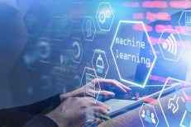
WHY MACHINE LEARNING ?
No human experts
Black – box human expertise
Rapidly changing phenomena
Need for customization

Slide 5
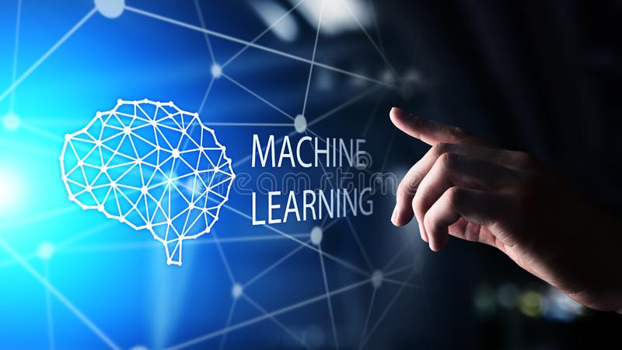
WHAT IS LEARNING ?
“learning is making usefull changes in our mind”
- MARVIN MINSKY
“Learning is constructing representations of what is being experienced.”
- RYSZARD MICHALSKI
“Learnng denotes changes in system that enable a system to do the same task more effficiently the next time”
-HERBERT SIMON

Slide 6
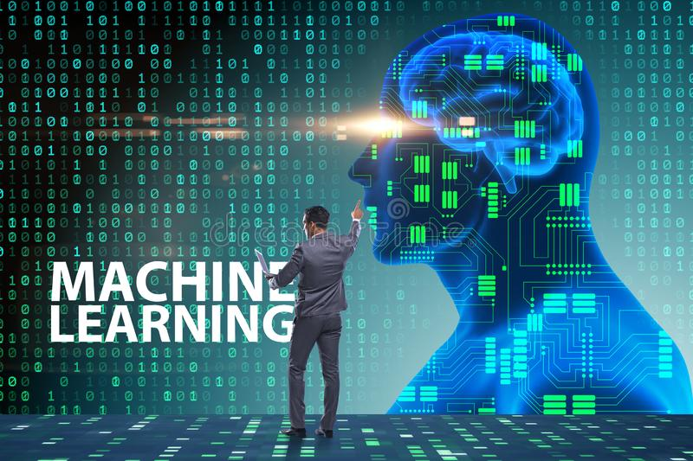
RELATED FIELDS :
Information theory.
Statistics.
Data base .
Data mining.
Evaloutional models.
Neuro science.
Cycological models.
Coontrol and decision theory.

Slide 7
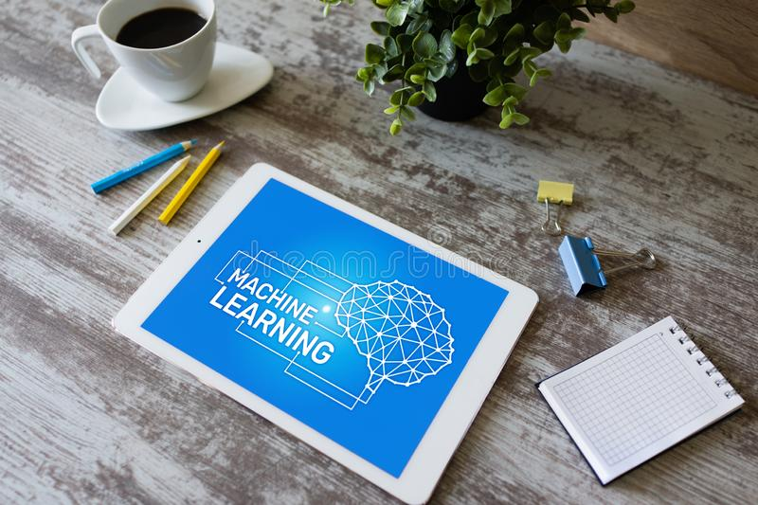
SUPERVISED LEARNING :
It is the machine learning task of learning a function that maps an input to an output based on example input – output pairs.
It infers a function from labled training data consisting a set of training examples.

Slide 8
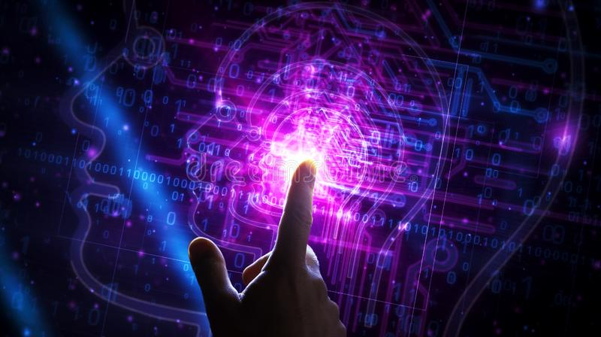
UNSUPERVISED LEARNING :
It is the type of machine learning that looks for previously undetected patterns a data set with no pre-existing labels and with a minimum of human supervision.

Slide 9
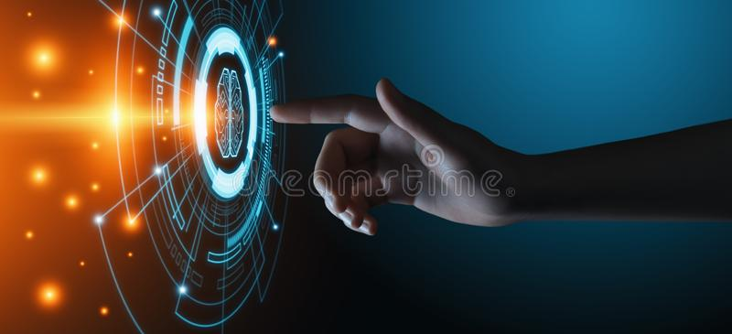
APPLICATION OF ML FROM DAY-TO-DAY LIFE :
Video surveillance
Social media services.
Online customer support.
Product recommendations.
Search engine result refining.
Email spam
Malware filter.
Etc.,

